Slide 1
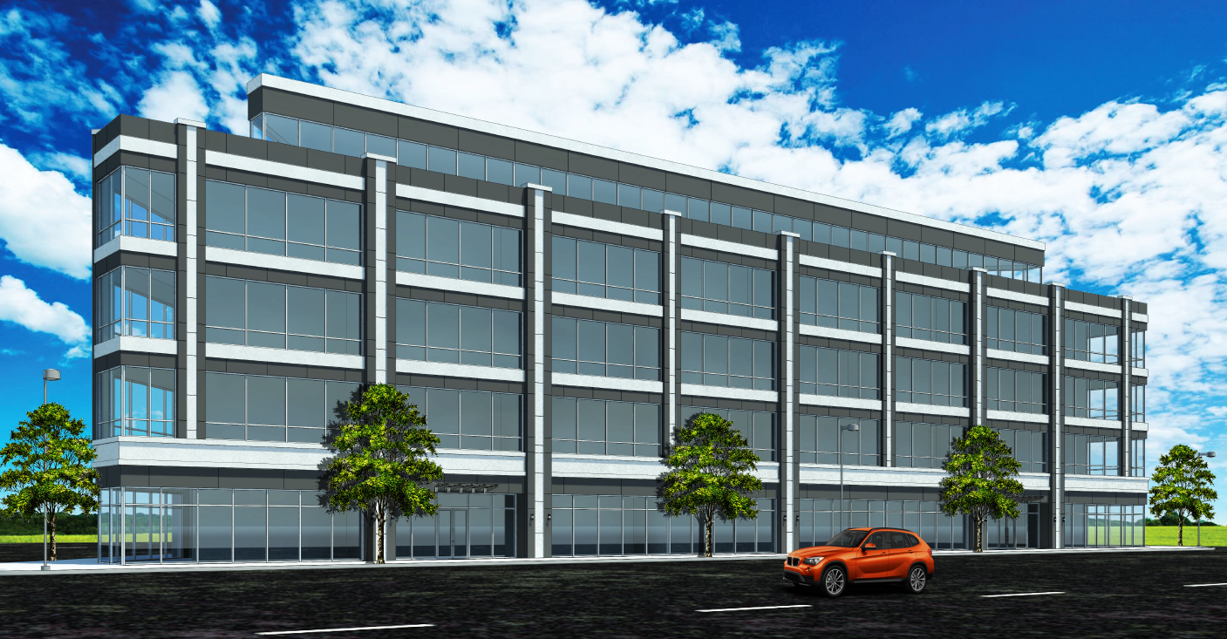
Prime Ground Floor Retail & Office Space for Lease
Queens Blvd Corridor, Rego Park Neighborhood
Please Contact Exclusive Advisor: Michelle Abramov at michelle@assetcrg.com or 718-607-1920

Slide 2
Ground Floor Retail 16,180 SF Available
Lower Level Retail 18,885 SF Available
Second to Fourth Floors Retail/Office of 17,750 SF Available Per Floor
Fifth Floor Retail/Office of 8,602 SF Available Per Floor
Sub-Cellar will be dedicated parking of 240 Parking Spaces
Features
Block-Thru Development with over 300 Feet of Frontage and Three Street Side Exposure
High Ceiling Heights
Exceptional Light & Air with a Rooftop Terrace
98-85 queens Blvd.
Rego park, NY 11375
Ground up development
Retail & office leasing Opportunity
Total Lease Availability is 97,000 SF
Built-to-Suit Opportunity
Please Contact Exclusive Advisor: Michelle Abramov at michelle@assetcrg.com or 718-607-1920

Slide 3
Confidentiality Disclaimer
The information contained in the following Marketing Brochure is proprietary and strictly confidential. It is intended to be reviewed only by the party receiving it from Asset Commercial Realty Group, LLC (“AssetCRG”) and should not be made available to any other person or entity without the written consent of AssetCRG. This Marketing Brochure has been prepared to provide summary, unverified information to prospective purchasers, and to establish only a preliminary level of interest in the subject property. The information contained herein is not a substitute for a thorough due diligence investigation. AssetCRG has not made any investigation, and makes no warranty or representation, with respect to the income or expenses for the subject property, the future projected financial performance of the property, the size and square footage of the property and improvements, the presence or absence of contaminating substances, PCB's or asbestos, the compliance with State and Federal regulations, the physical condition of the improvements thereon, or the financial condition or business prospects of any tenant, or any tenant’s plans or intentions to continue its occupancy of the subject property. The information contained in this Marketing Brochure has been obtained from sources we believe to be reliable; however, AssetCRG has not verified, and will not verify, any of the information contained herein, nor has AssetCRG conducted any investigation regarding these matters and makes no warranty or representation whatsoever regarding the accuracy or completeness of the information provided. All potential buyers must take appropriate measures to verify all of the information set forth herein.

Slide 4
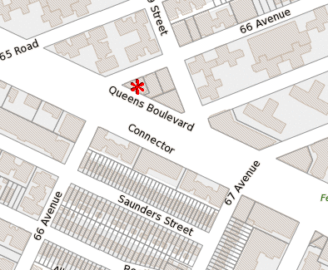
Investment Highlights
Neighborhood Features
Rego Park offers a high density of residential high rises and apartment buildings and a growing middle class with diverse demographics.
This opportunity offers a built-to-suit opportunity for office, medical, and retail tenants, on the prime retail and transit oriented corridor of Queens Blvd. in Rego Park
Core Education oriented neighborhood: ·The Kew-Forest School (oldest private school in Queens), P.S. 196, Forest Hills High School , J.H.S 190 Russel Sage, P.S. 139, Bramsonort College, Plaza College, Touro College, DeVry College
Core Medical oriented neighborhood: Northwell/LIJ, CityMD, Quest Diagnostics, Queens Medical Imaging, Mount Sinai Medical Associations
Building Features
Total Building size is roughly 130,000 SF on a lot size of 21,472 SF
Entire Block-Thru site
Three Frontages on Queens Blvd (273’), 66th Avenue (200’) and 99th Street (200’)
The Whole Building is Available for a Built to Suit Opportunity
240 Dedicated Parking Spaces Available On-Site
ICAP Tax Abatement will be Secured
Delivery Date is estimated to be Spring of 2022
Transportation
Multiple Buses, LIRR, and Subway Lines within a minute walking distance
Queens Blvd which leads into Midtown Manhattan—15 minute drive from Property

Slide 5
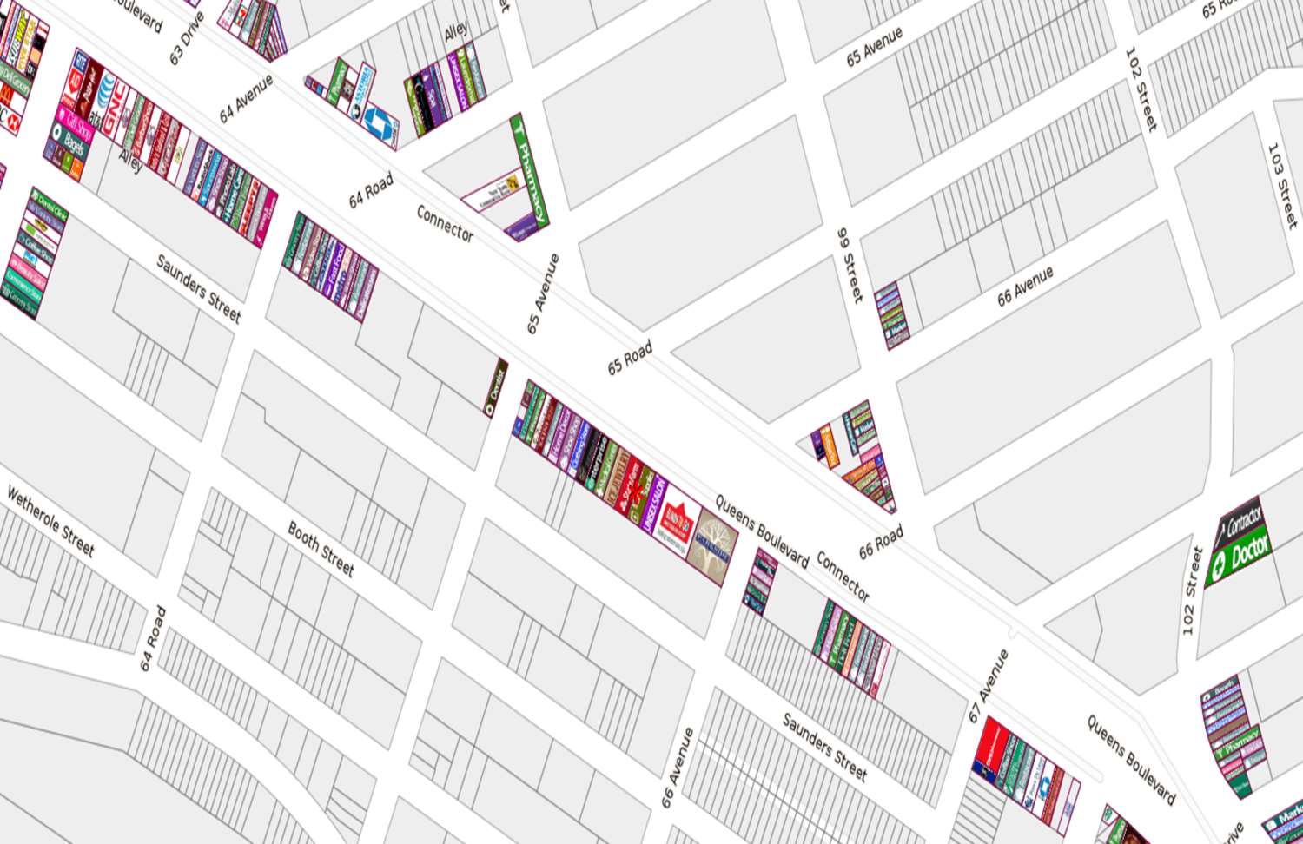
Retail Map

Slide 6
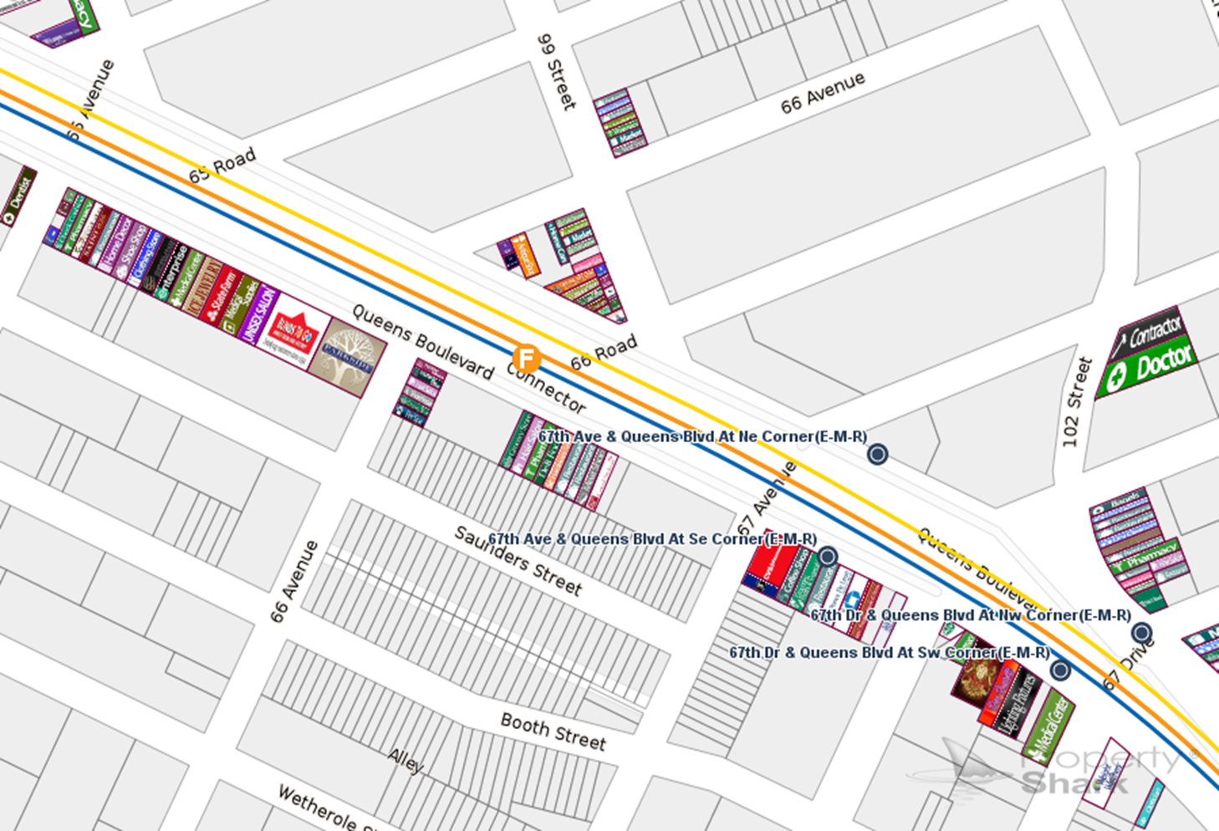
Map & Transportation

Slide 7
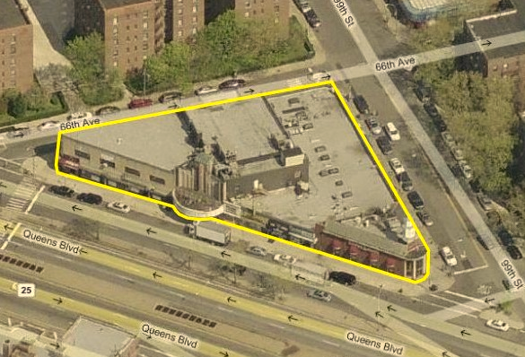
Current Site

Slide 8
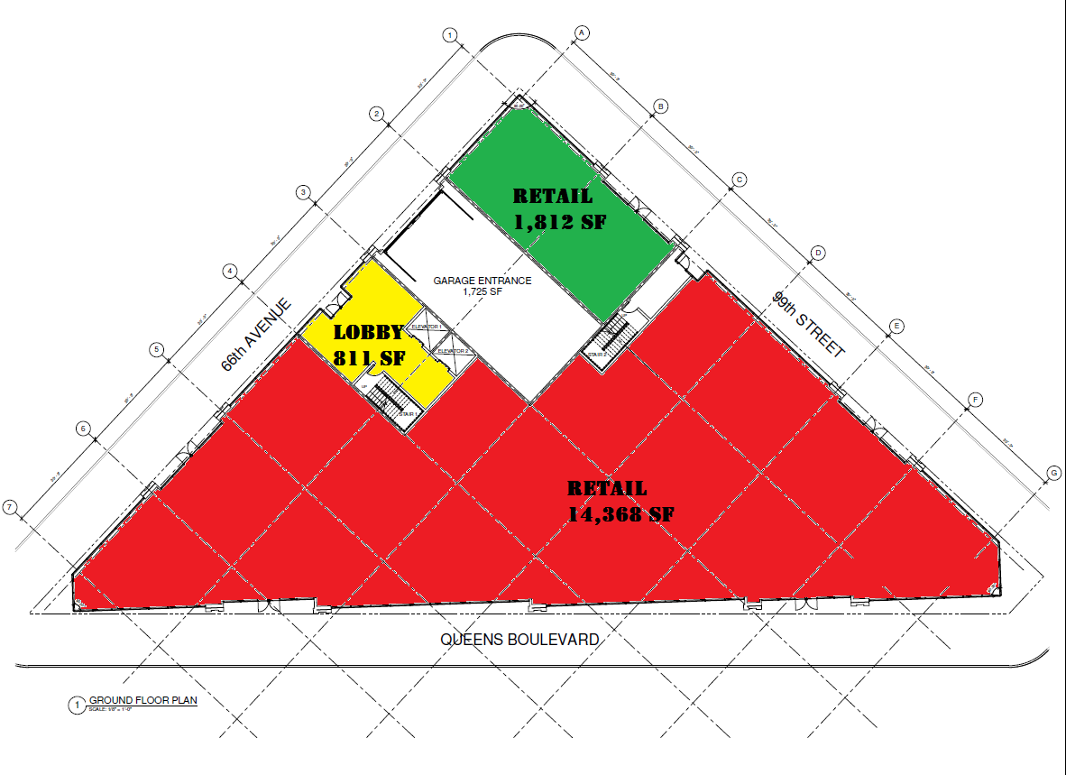
Floor Plans
Ground Floor
RETAIL 1
1,812 RSF
End-cap (99th Street 66th Avenue)
Built to Suit Opportunity
RETAIL 2
14,368 RSF
Over 300+ feet frontage
Wrap around on Queens Blvd
Built to Suit Opportunity

Slide 9
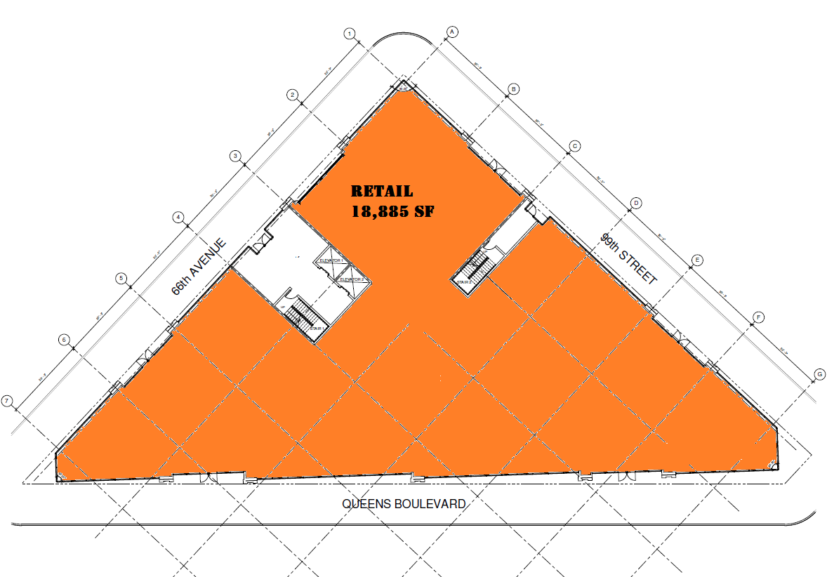
Floor Plans
Lower Level (Cellar)
RETAIL
18,885 RSF
Can be Sub-Divided
High Ceiling Heights
Built to Suit Opportunity
107-02 Queens Blvd
Forest Hills, NY 11375
534 William Floyd Parkway
Shirley, NY 11967

Slide 10
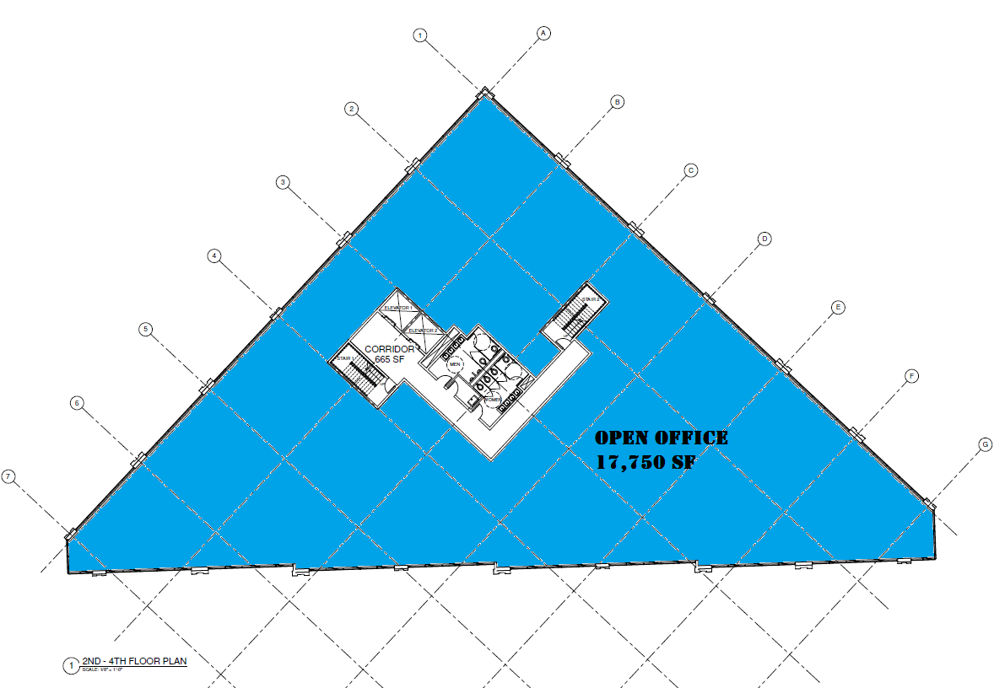
Floor Plans
Second-Fourth Floors
RETAIL or Open Office
17,750 RSF per Floor Plate
Built to Suit Opportunity
14 Feet in Ceiling Height
Can be Contiguous Space for Retail and/or Office

Slide 11
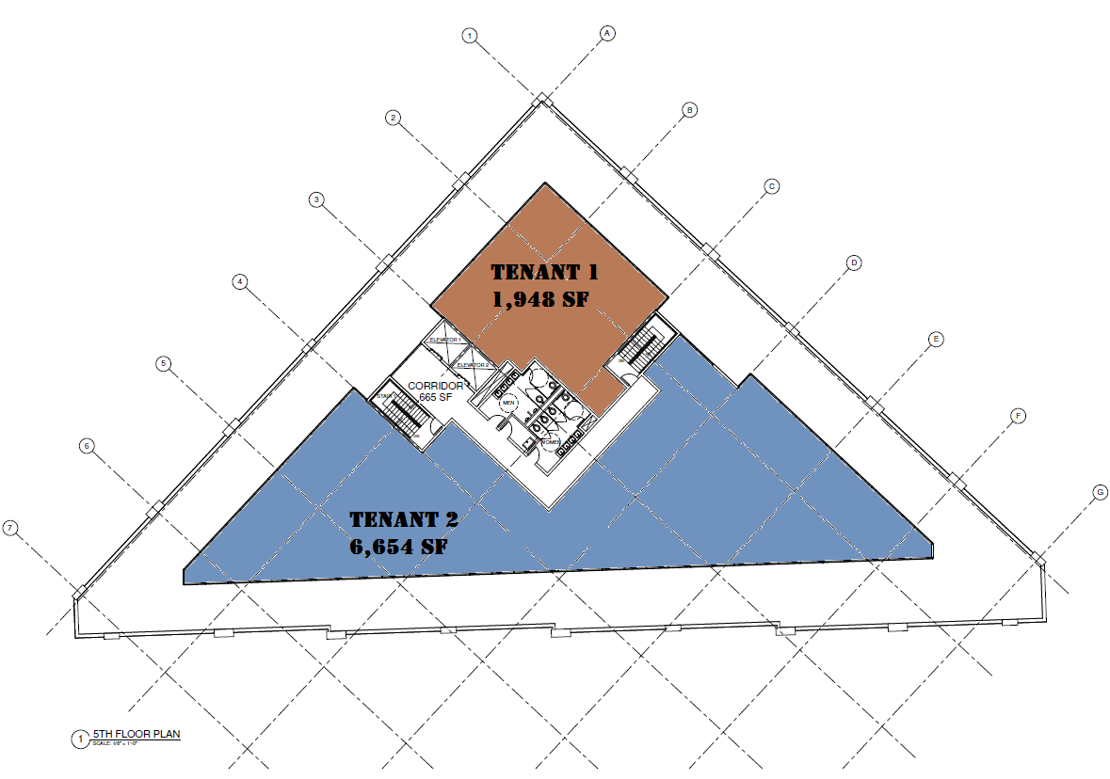
Floor Plans
Fifth Floor
RETAIL or Open Office 1
1,948 RSF
Built to Suit Opportunity
14 Feet in Ceiling Height
Roof Terrace
RETAIL or Open Office 2
6,654 RSF
Built to Suit Opportunity
14 Feet in Ceiling Height
Roof Terrace

Slide 12
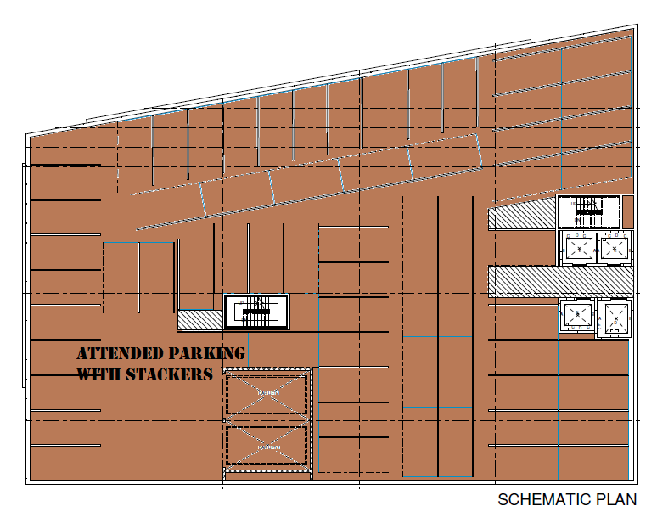
Floor Plans
Second Sub-Cellar
Attended Parking with Stackers
Over 240 Deeded Parking Spaces Combined

Slide 13
Demographics
Population | 1-mi. | 3-mi. | 5-mi.
2015 Male Population | 75,762 | 455,795 | 1,045,048
2015 Female Population | 79,666 | 467,133 | 1,076,316
2015 Total Population | 155,428 | 922,928 | 2,121,364
2015 Households | 57,325 | 316,870 | 724,541
Housing | 1-mi. | 3-mi. | 5-mi.
2015 Housing Units | 59,888 | 325,657 | 733,072
2015 Occupied Housing Units | 57,925 | 314,237 | 701,111
2015 Owner Occupied Housing Units | 16,505 | 110,309 | 249,506
2015 Renter Occupied Housing Units | 41,420 | 203,928 | 451,605
Income | 1-mi. | 3-mi. | 5-mi.
2015 Household Income: Median | $53,965 | $54,272 | $53,256
2015 Household Income: Average | $72,192 | $73,327 | $72,397

Slide 14
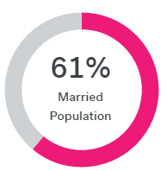
Demographics Cont’d

Slide 15
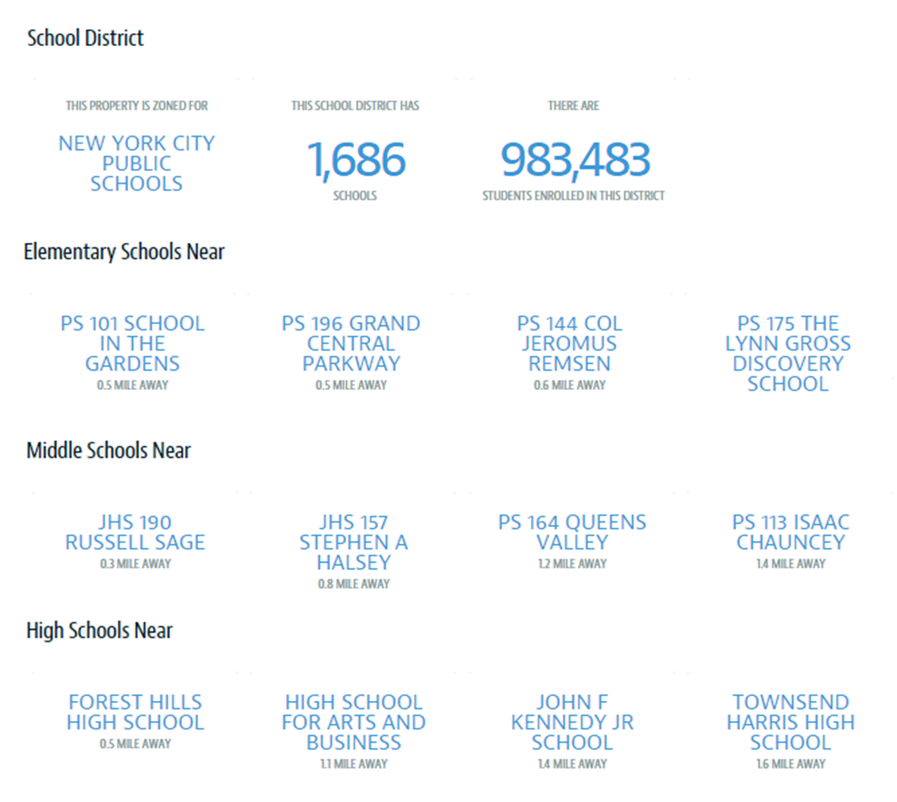
Education

Slide 16
Contact For More Information
PLEASE CONTACT EXCLUSIVE ADVISOR:
Michelle Abramov
Managing Principal
michelle@assetcrg.com | Office: (646)-767-6975 |Cell: (718) 607-1920
Broker Cooperation is Welcome!

